Slide 1



Satellite Ground Station in Gdańsk
Sławomir Figiel Tomasz Mrugalski Ewelina Omernik
software developer project manager, analyst / designer hardware engineer
Space and Satellite Technologies
14 January 2020

Slide 2
Agenda
Motivation
Project schedule
Project Design & Architecture
Hardware selection (antennas)
Software for receiving process
Tough problems we faced
Summary, next steps

Slide 3

Long term objective:
Help building Polish space ecosystem by providing data downlink service
Project goals:
Design, implementation and operation of a ground station
Omnidirectional antenna (fixed)
UHF or VHF bandwidth
SDR (Software Defined Radio)
Embedded platform (Raspberry Pi)

Slide 4
Project Schedule
No. | Task | Deadline
1 | Feasibility study | 2019-10-17
2 | Hardware acquisition | 2019-11-07
3 | System integration | 2019-11-14
4 | Software automation design | 2019-11-21
5 | Software implementation | 2019-12-19
6 | Test campaign | 2020-01-09

Slide 5

Architecture
Problems solved
SDR
DSP CPU
content
server
Internet
antenna
Hardware (band, SDR, antenna, LNA, computing platform, …)
UHF or VHF bandwidth
Location (antenna installation, cabling)
Software configuration
Automation
Results visualization

Slide 6

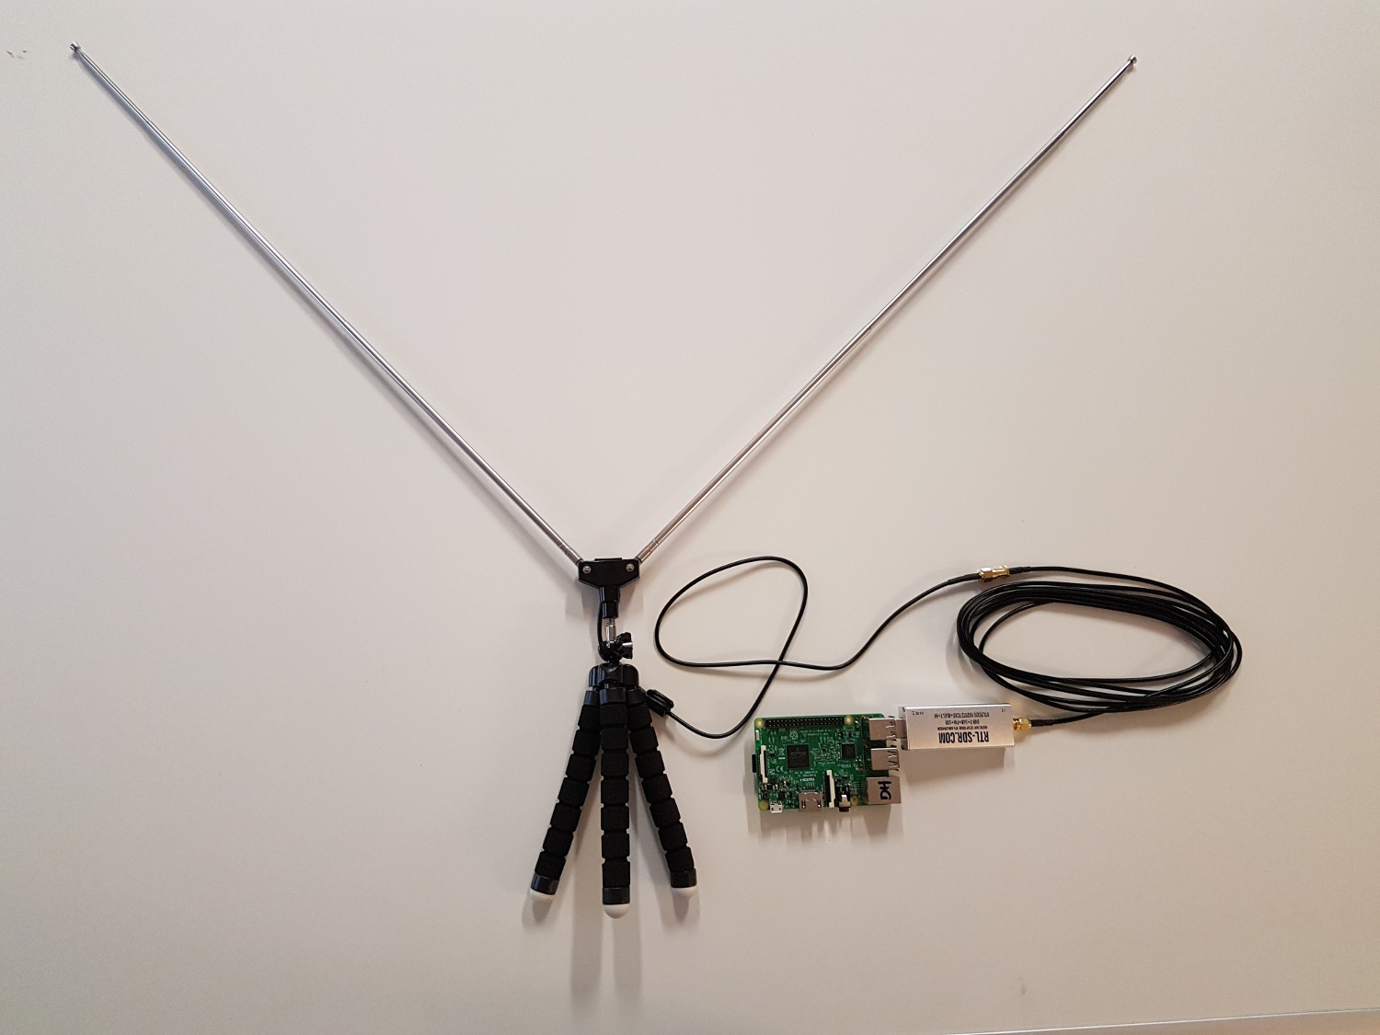
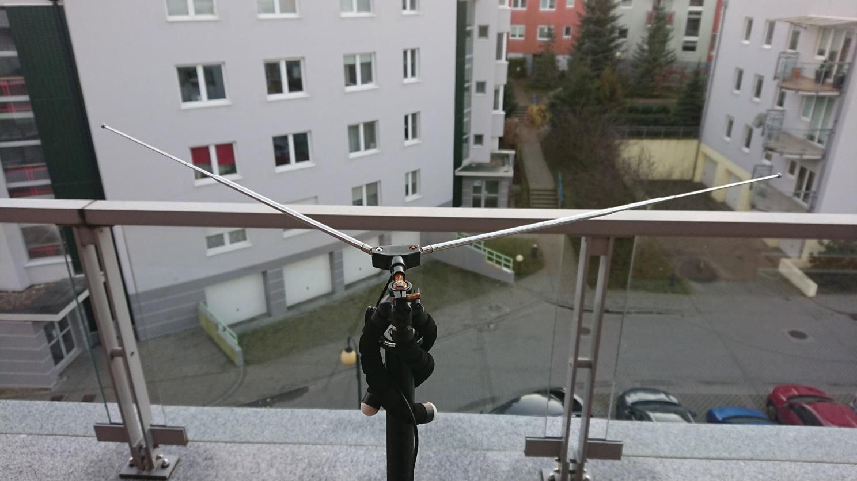
Antenna v1

Slide 7
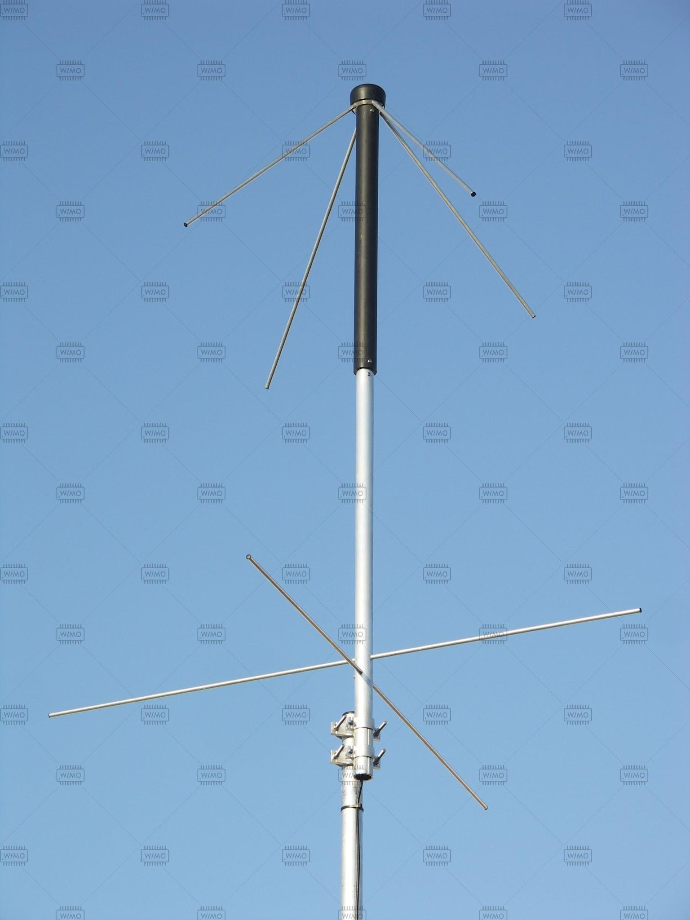
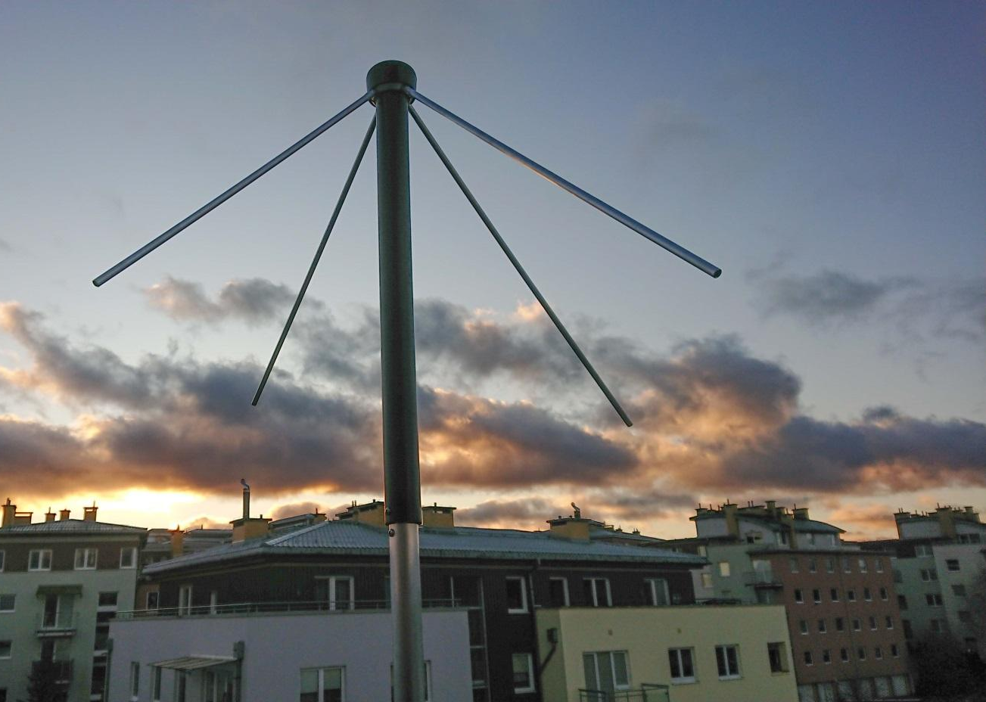
Antenna v2 - TA-1 Turnstile

Slide 8
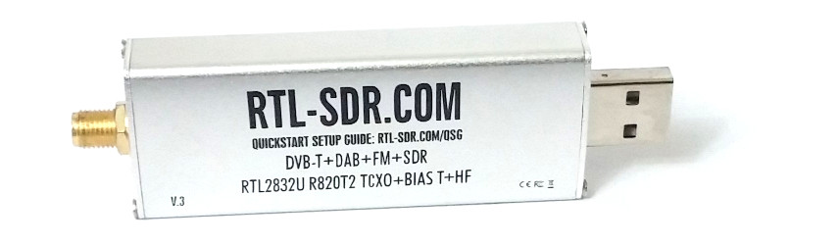
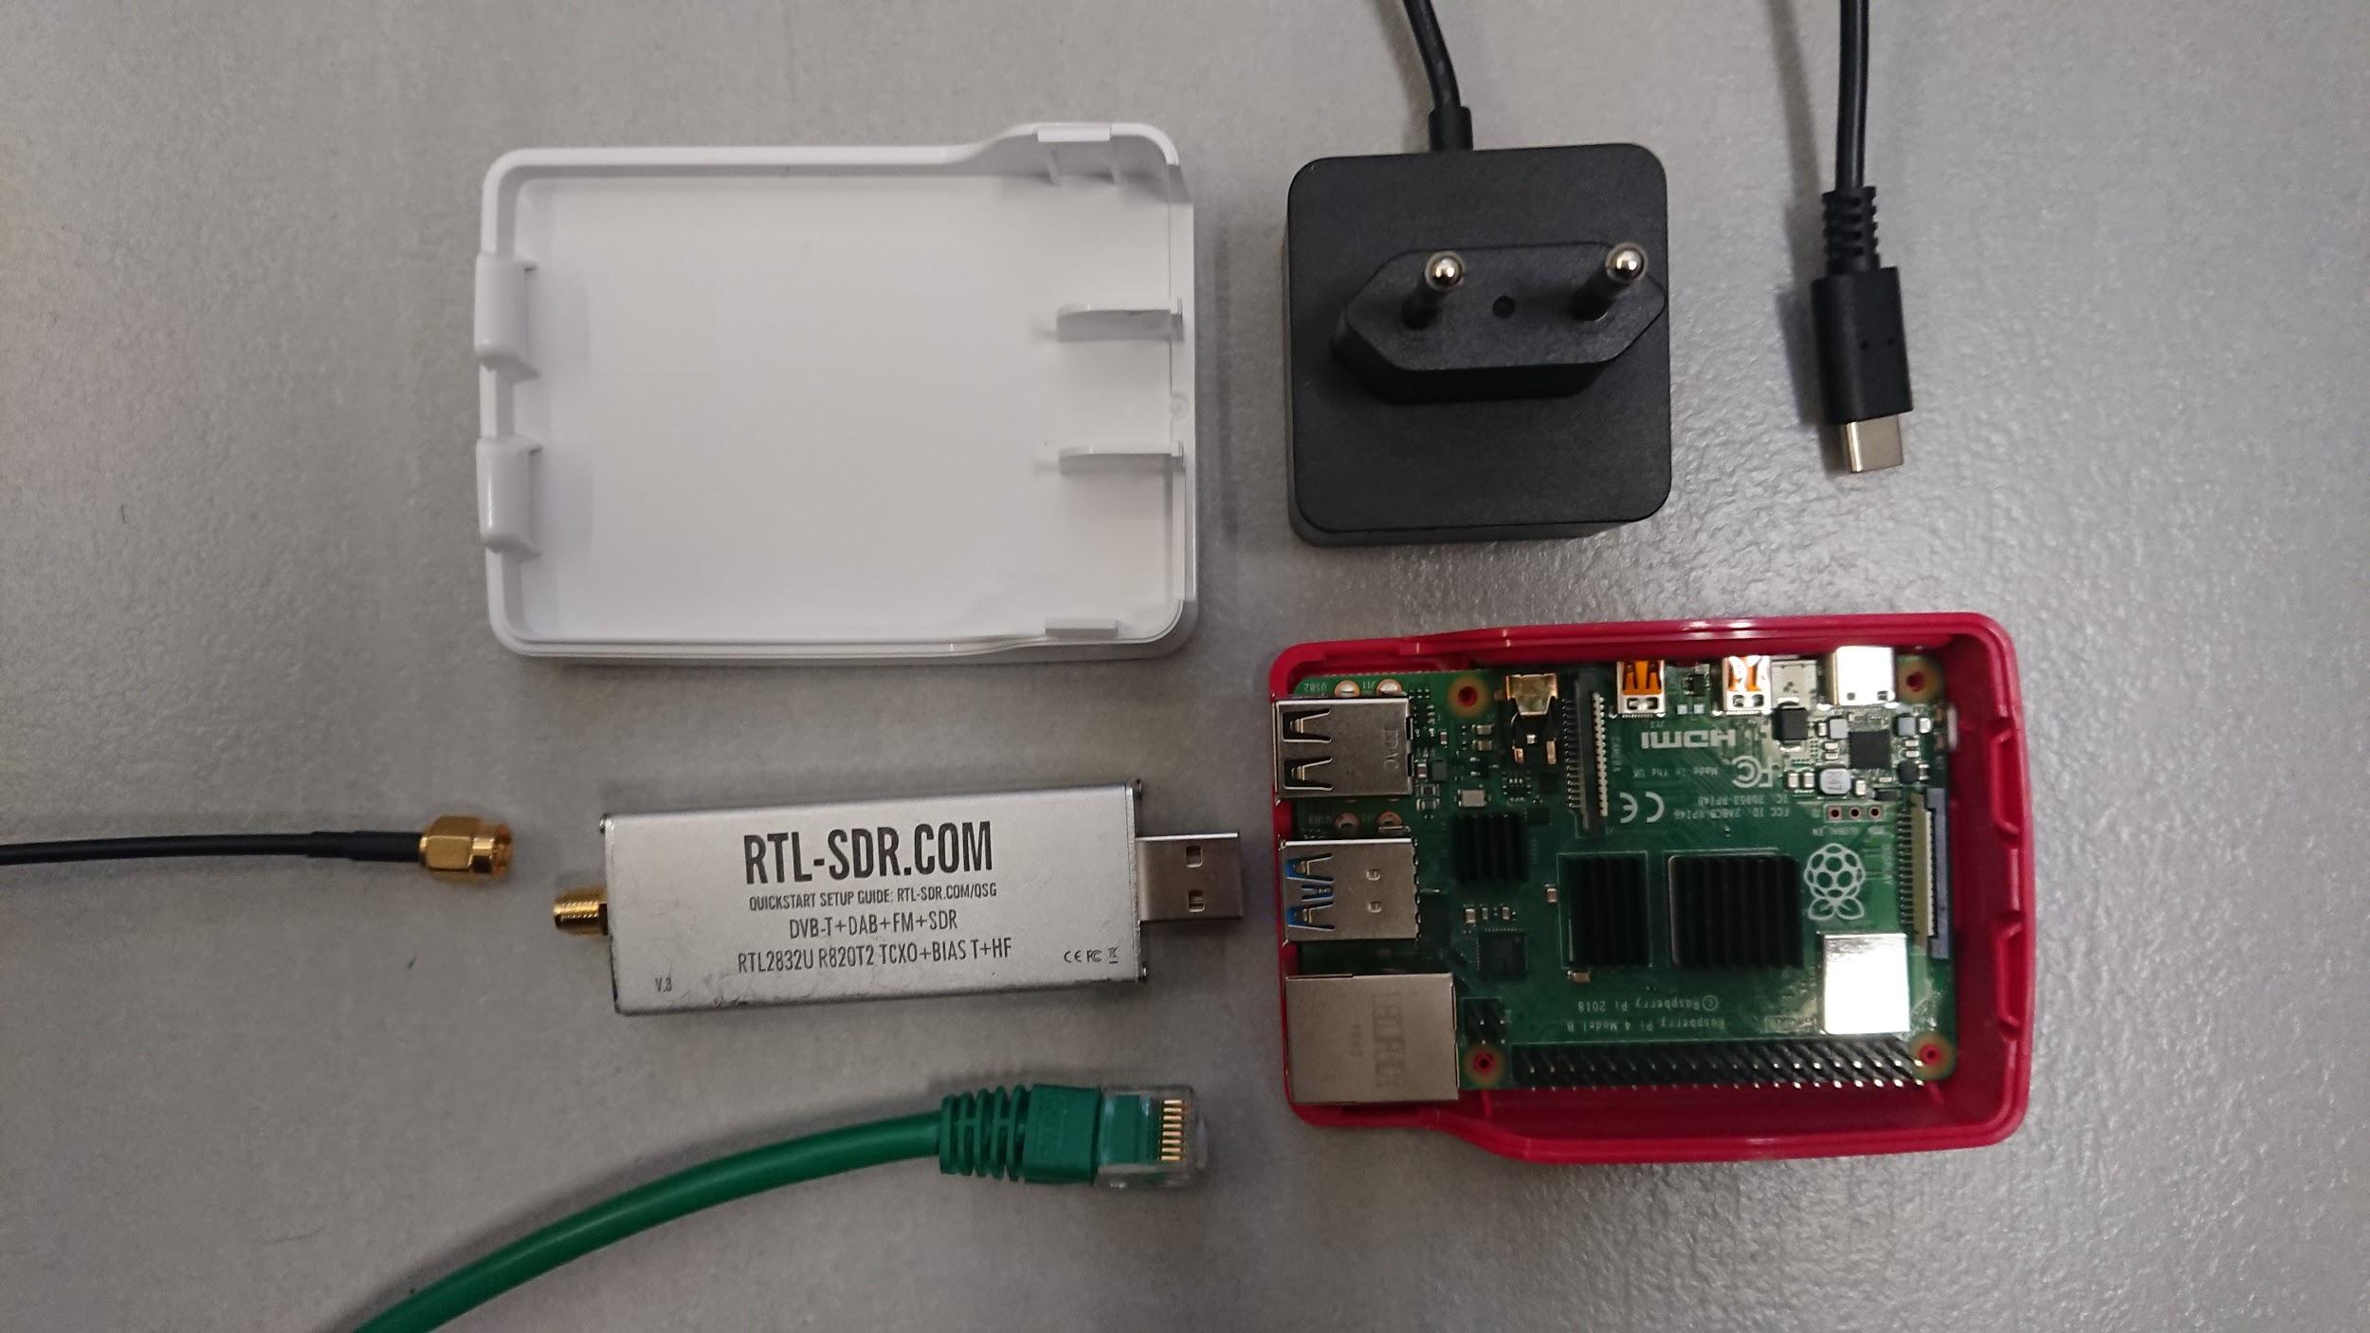
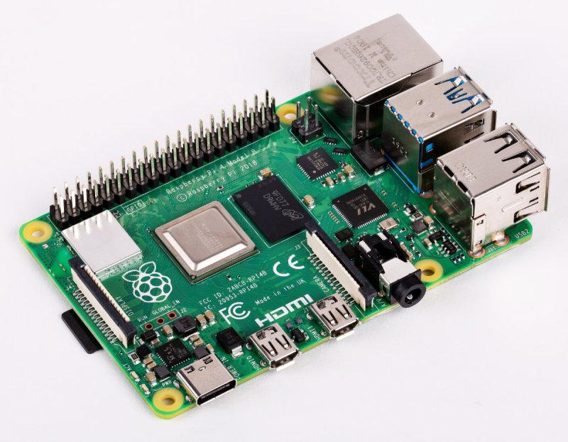
SDR + RPi

Slide 9
How to receive a sat transmission in 5 easy steps

Slide 10
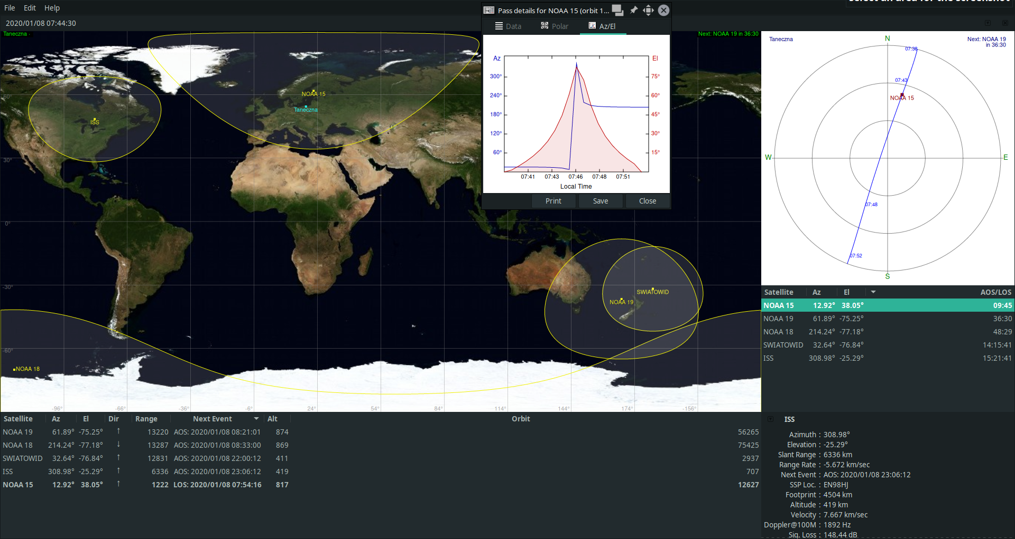
Step 1: Predict satellite fly-over

Slide 11
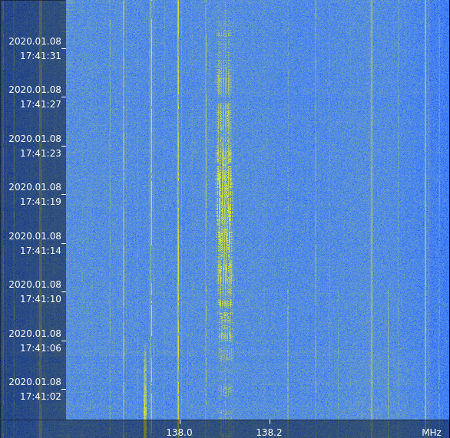
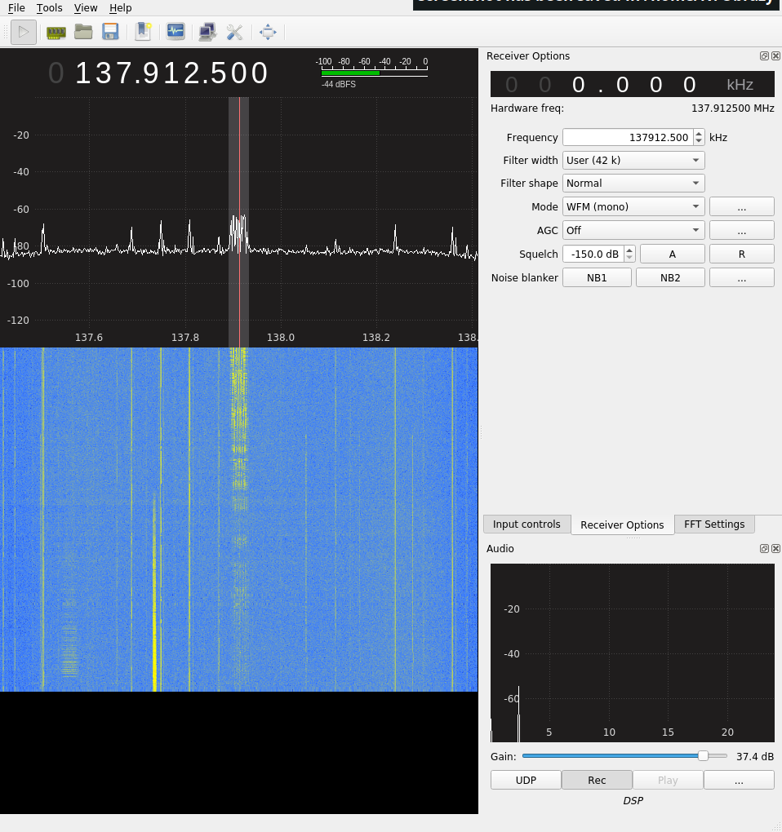
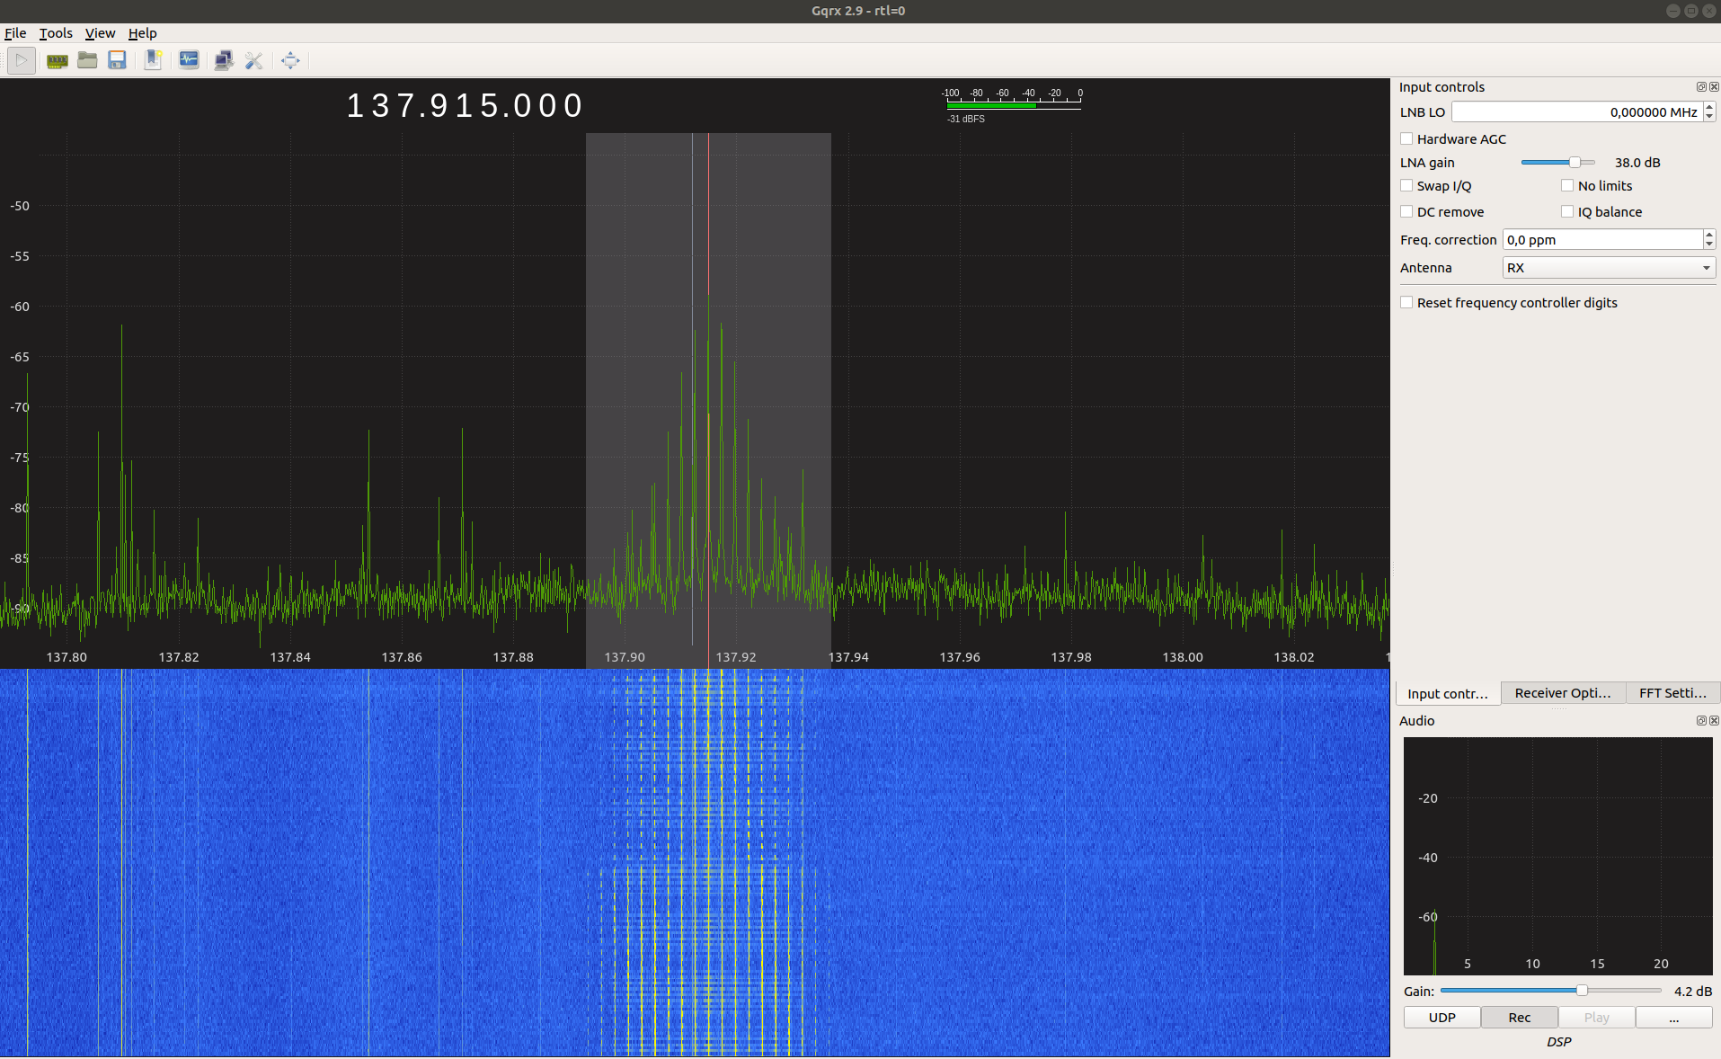
Step 2: Tune SDR to transmission frequency

Slide 12
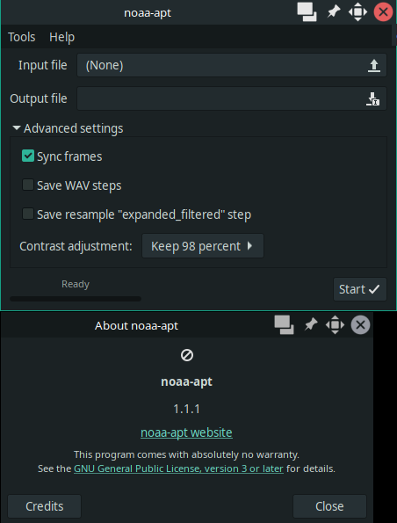
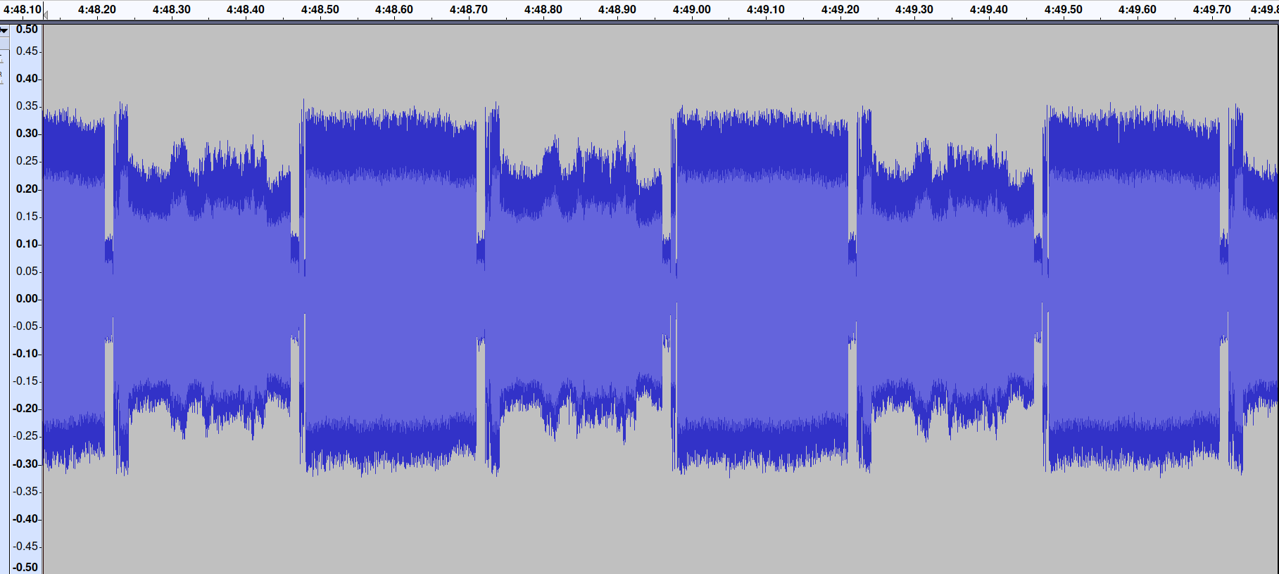
Step 3: Decode transmission

Slide 13
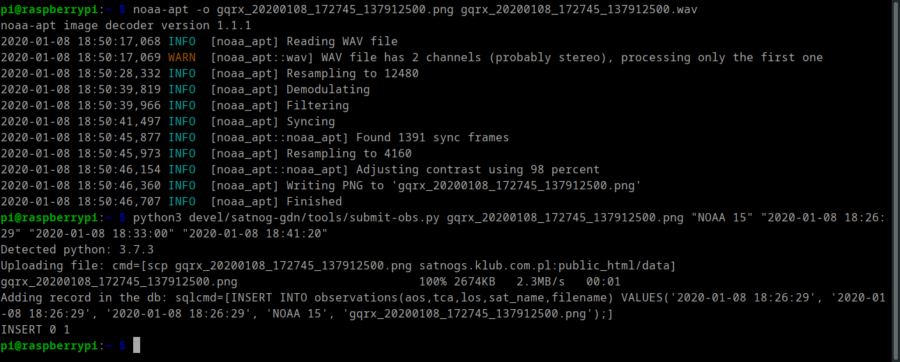
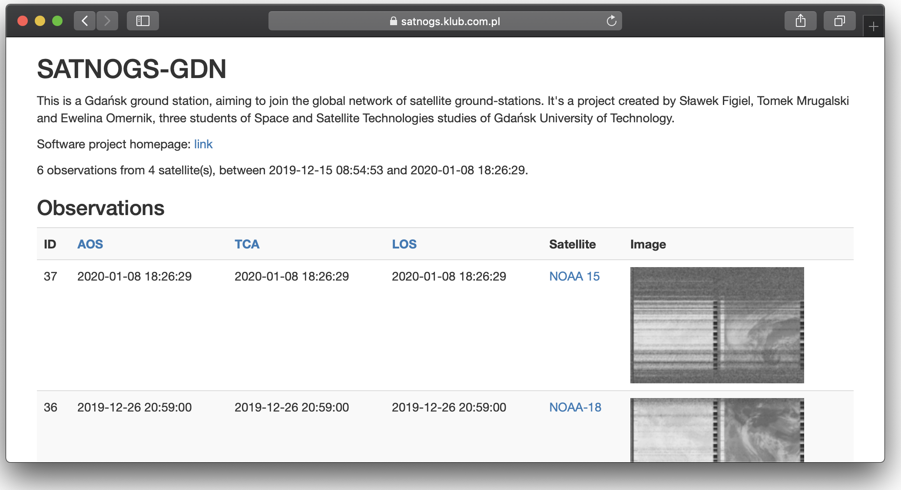
Step 4: Upload to content server
https://satnogs.klub.com.pl/

Slide 14
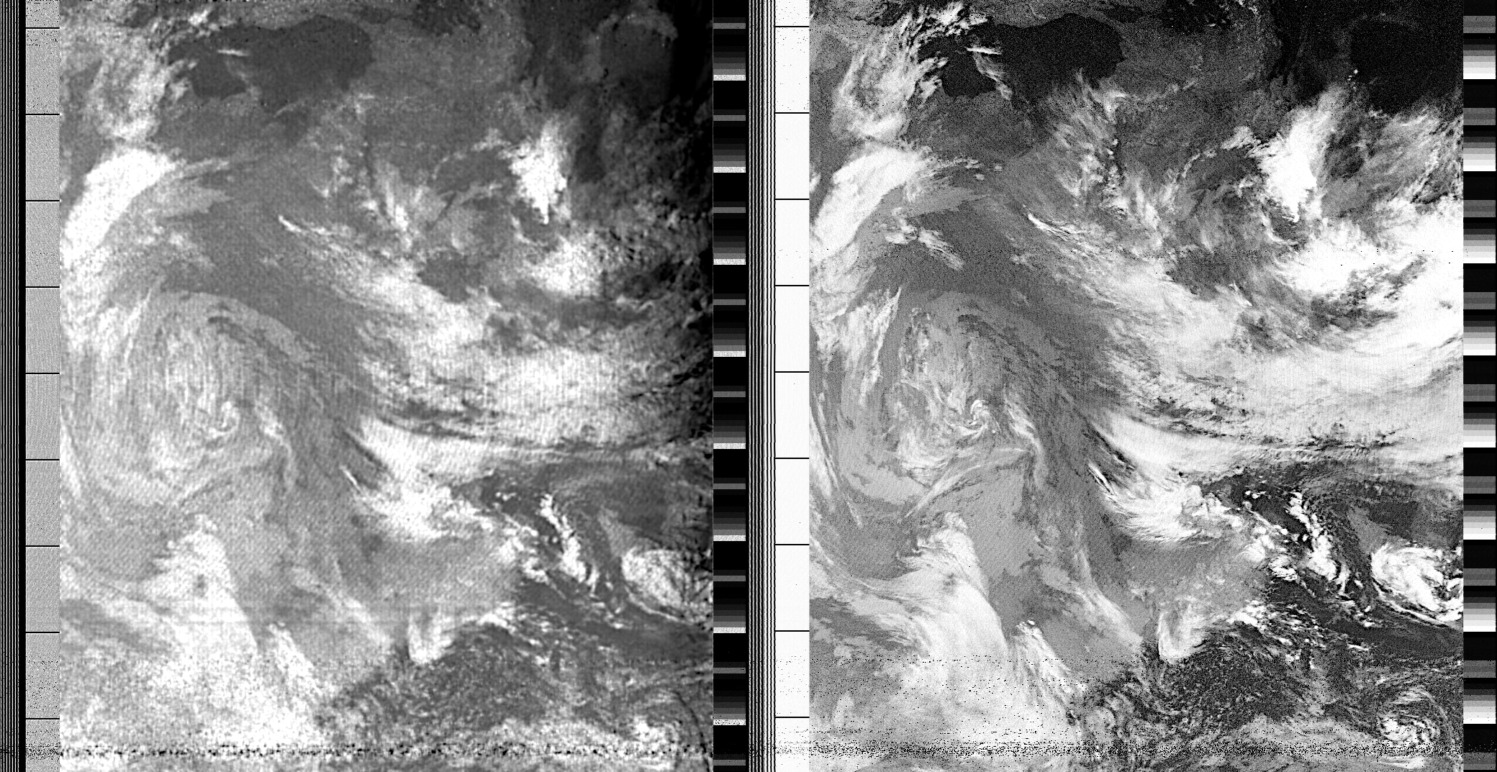
Step 5: Profit!
854km, sun-synchronous
4km/pix

Slide 15
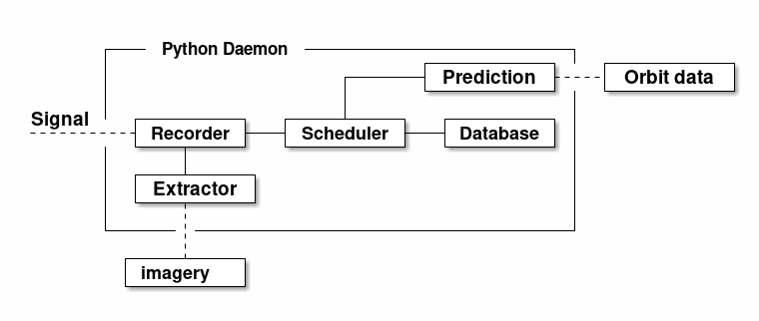
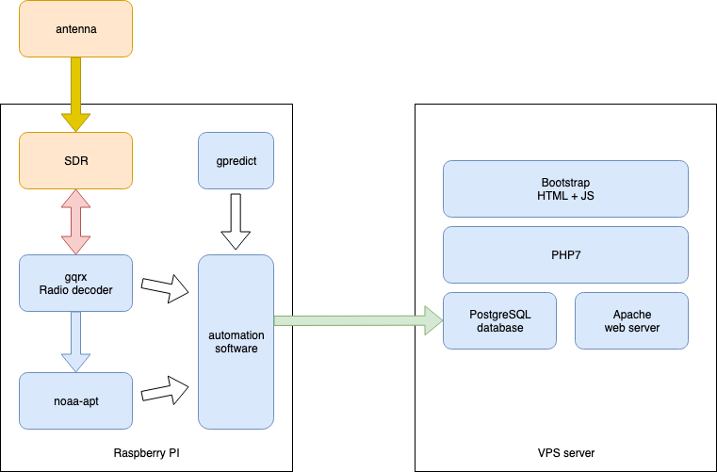
Automation
Realization
Concept

Slide 16
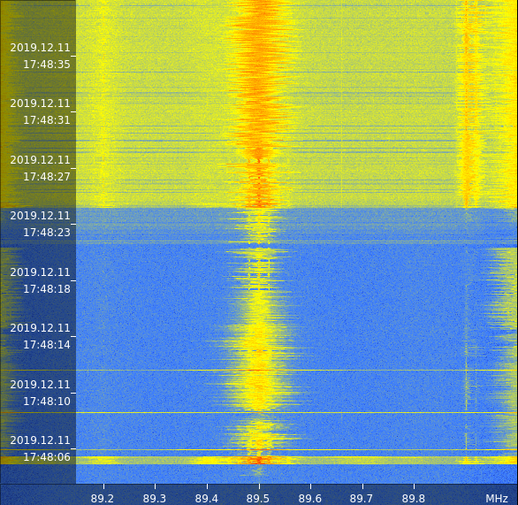
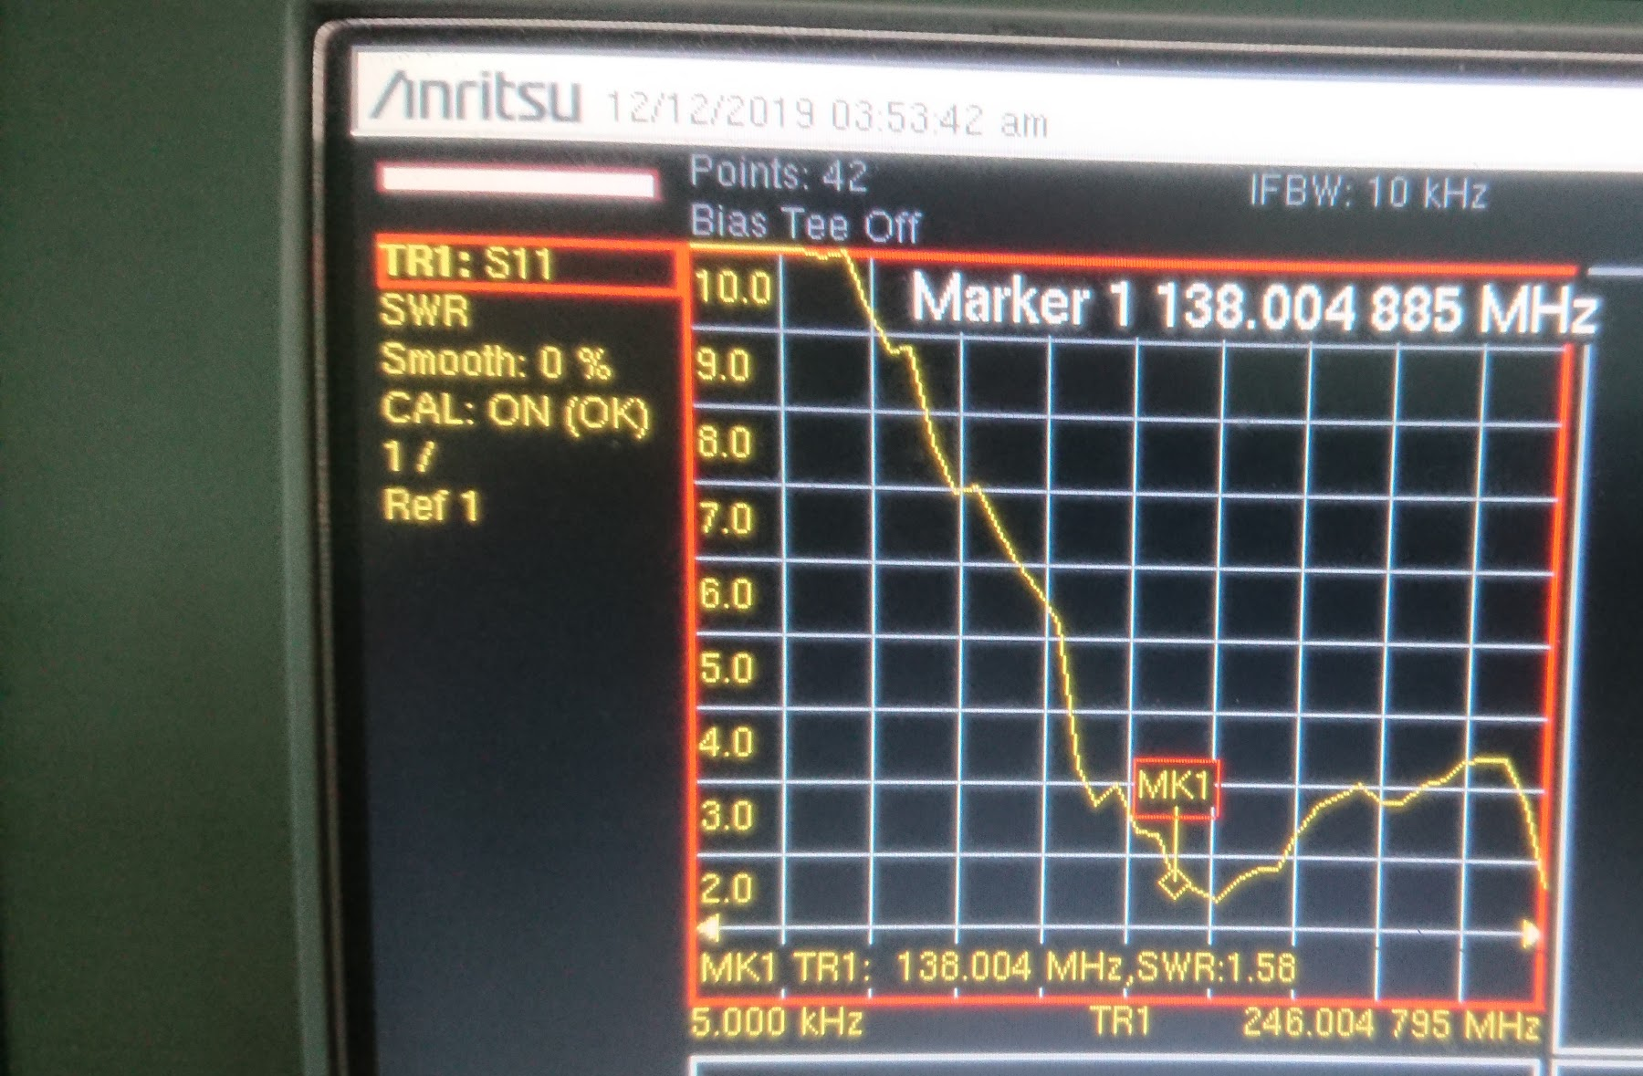
Troubleshooting
SWR measurements
Broken new antenna
Prototype antenna
Notes:
acknowledgements

Slide 17

Next steps
Results
First satellite ground station in northern Poland
Research data gathering started
100% open source
Publish on Github
Better code and improve web interface
Connect to SATNOG network
Switch to directional antenna
Switch to UHF, S and X band
Cooperation with amateur Cubesat projects

Slide 18

https://satnogs.klub.com.pl/

